Slide 1
Mission Enabler Training January 2024

Slide 2
CULTURE

Slide 3
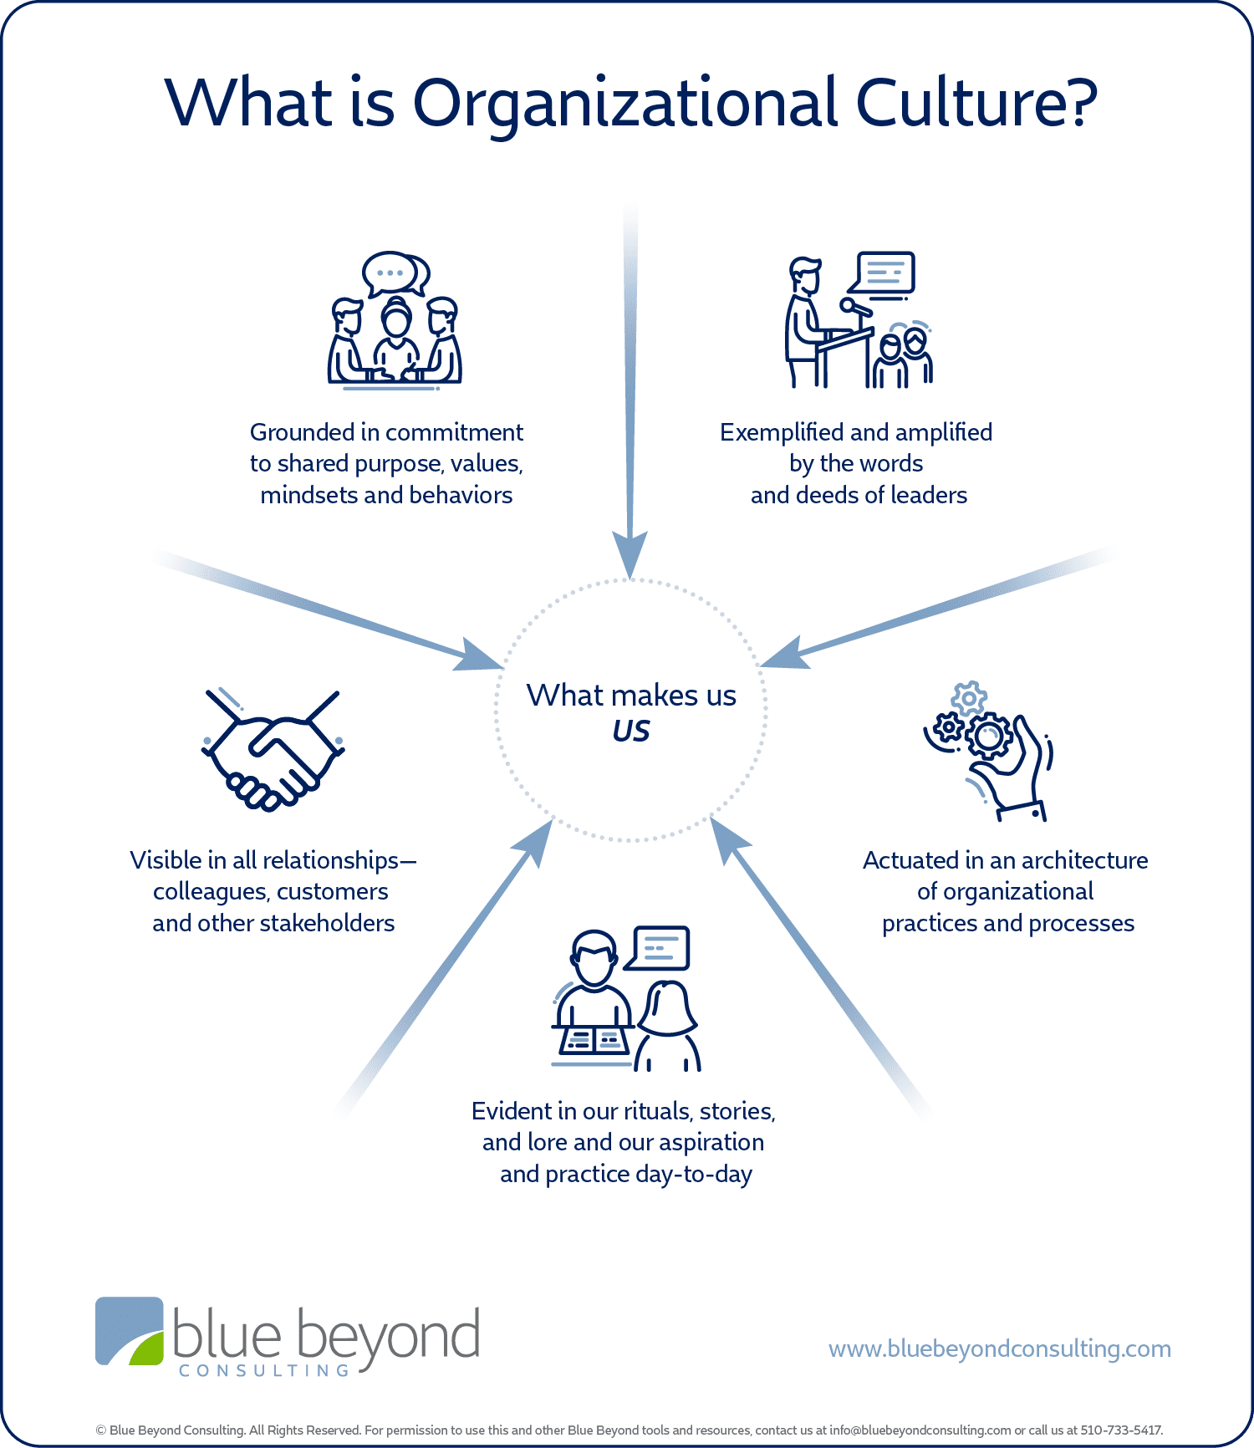
What is culture?

Slide 4
What is our CBA culture?

Slide 5
Welcome Transparency Partnership Integrity Disciple making Distributed leadership

Slide 6
Grounded Exemplified Amplified

Slide 7
Mission Enabler Training January 2024

Slide 8
Vision Day

Slide 9
Grounded Exemplified Amplified

Slide 11
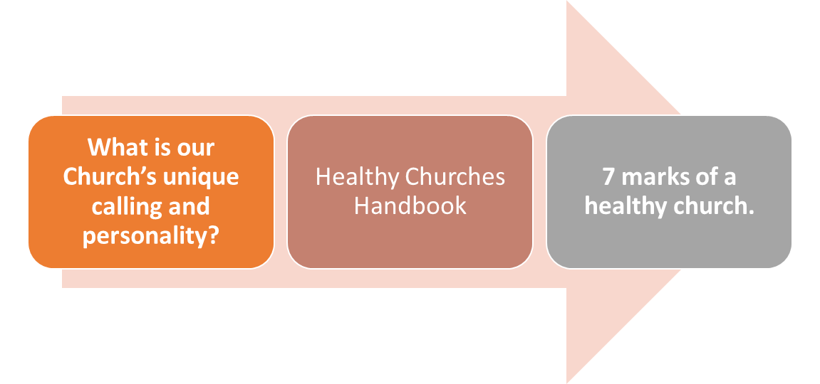

Slide 15
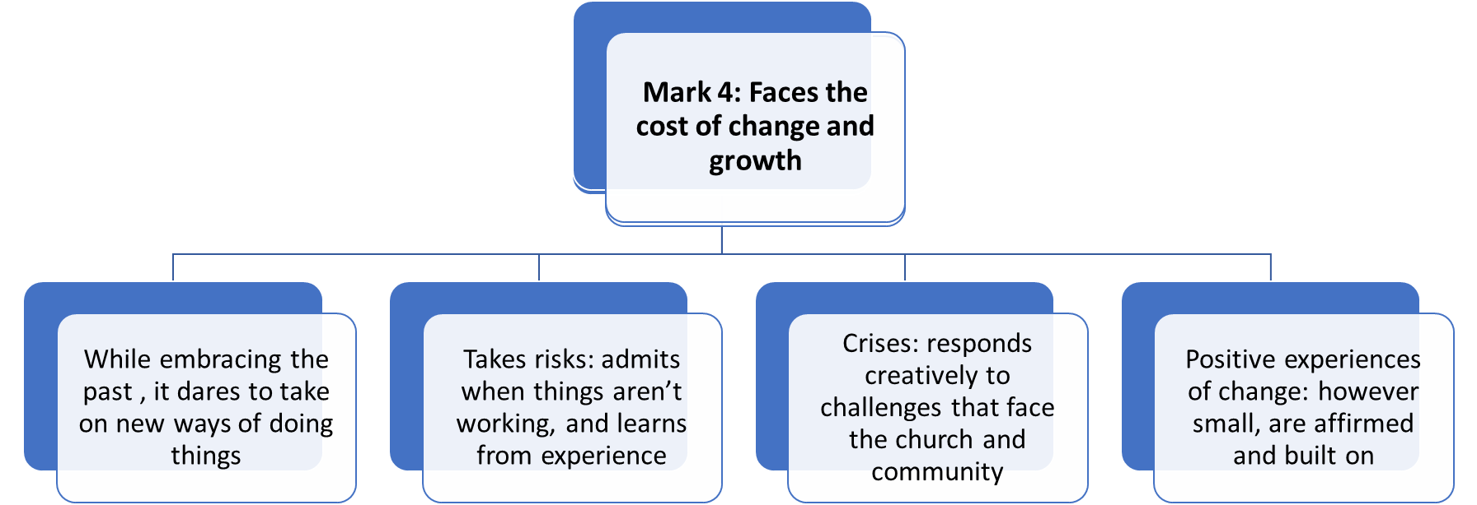

Slide 19
Why this helps us
Knowing what we are good at…
Knowing what we need to work on…
Knowing what gifting and skill mix we are looking for in the next minister…
Not waiting until they arrive to get started…

Slide 20
Mission Enabler Training January 2024

Slide 21
COMMUNITYPROFILE

Slide 22
Define your community! Buy/download an up-to-date map (add new estates as you can) maps.google.com has an editable map system that could be helpful - otherwise colour coded pins are good!
List HARD DATA Churches Businesses (relevant) Charities Community Groups Any other group that works within the community

Slide 23
Plot the groups on the map according to where they are active or meet.
maps.google.com (you will need a google account to log in)
Saved (under the side bar) > maps tab > open My Maps
Create a new map > add a base map
Use a layer for each category of community group/business to mark and highlight (use the search to bring up the obvious ones and add manually any others that you know)
Untitled layer > rename layer for each group type (under the dots) > open data table and input names > right click > replace with marker > place marker in correct location (repeat as necessary)

Slide 24
Looking at all the data work out where the gaps for the community are.
Look at businesses to see if they are targeting every demographic.
Look at schools and see if there are breakfast clubs/holiday meal provisions/before and after school care.
Look at churches and find out what their website says they’re doing.

Slide 25
To go along with the map and analysis – there is more hard data needed to understand who is in the community.
ons.gov.uk – is helpful if you can find a way to extract the right data.
uklocalarea.com – will help and is much easier to use
findahood.com – very similar and easy to use
Try to understand the statistics through the lens of what they mean for who is available and connected to your community and the provisions they may need.

Slide 26
SOFT DATA - Can be almost anything but involves a conversation rather than a statistic.
Focus group
Community survey
Conversations in community space
Webinaire
Facebook
Talking to councillors/PCC/community leaders
Why do any of this?
Because you will nearly always find out something you do not know.
Because the answer to ‘what is ours to do?’ will often be simple and ‘fit in’ to what needs there are in the community.

Slide 27
Mission Enabler Training January 2024

Slide 28
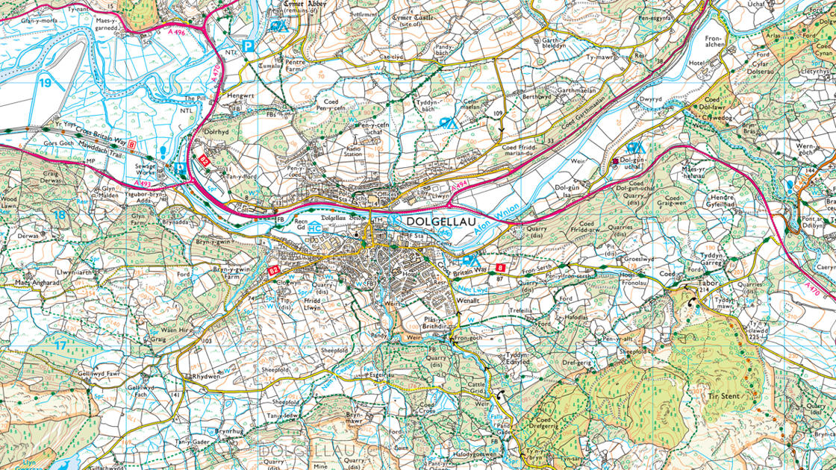
Mission Action Planning

Slide 29
Littletown Baptist Church have been supported by Home Mission in the past but currently have a pastoral vacancy. They would like to call a new minister and have started putting a church profile together. If the minister is to be appointed to a full-time post, a Growth Grant will be required to help towards the stipend. They are a small church with a multi-use space for the sanctuary but no hall and no car park. Their building is used by a private nursery school every weekday during termtime, which generates a reliable income but restricts the options for weekday outreach (unless it happens on different premises). The weekly seniors’ coffee morning has moved to the community library and the last Alpha course was held in the manse. There are no families with young children attending LBC, but there are some older teenagers and young adults. A drop-in youth group is held at the church on a Friday evening after the nursery school has cleared their equipment away for the weekend – it is staffed by church members on a rota. On Sunday afternoons the church is open for board games, puzzles and table tennis for anyone who would like some company (and a cuppa).

Slide 30
Mission Enabler Training January 2024

